Slide 1

Bringing People into AR
Huynh Bao Trung Nguyen, Andreas Stiller, Luke Gavin

Slide 2
Augmented Reality (AR)
immersive, engaging experiences that seamlessly blends virtual objects with the real world
device's camera presents the physical world onscreen live
app superimposes three-dimensional virtual objects, creating the illusion that these objects actually exist
reorient the device to explore the objects from different angles, interact with objects using gestures and movement, and even join other people in multiuser AR experiences
Offer AR features only on capable devices

Slide 3
ARKit
People Occlusion
Motion Capture
Simultaneous Front and Back Camera
Multiple Face Tracking
Collaborative Sessions
Additional Improvements like estimate of real world size

Slide 4
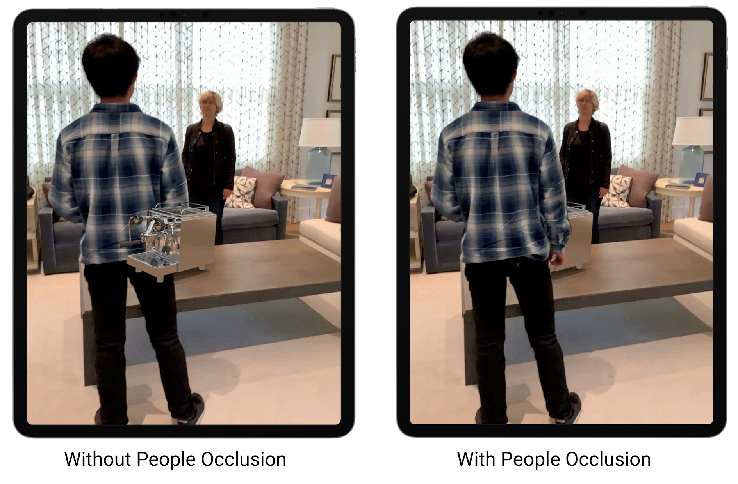
People Occlusion
Depth-ordering problem

Slide 5
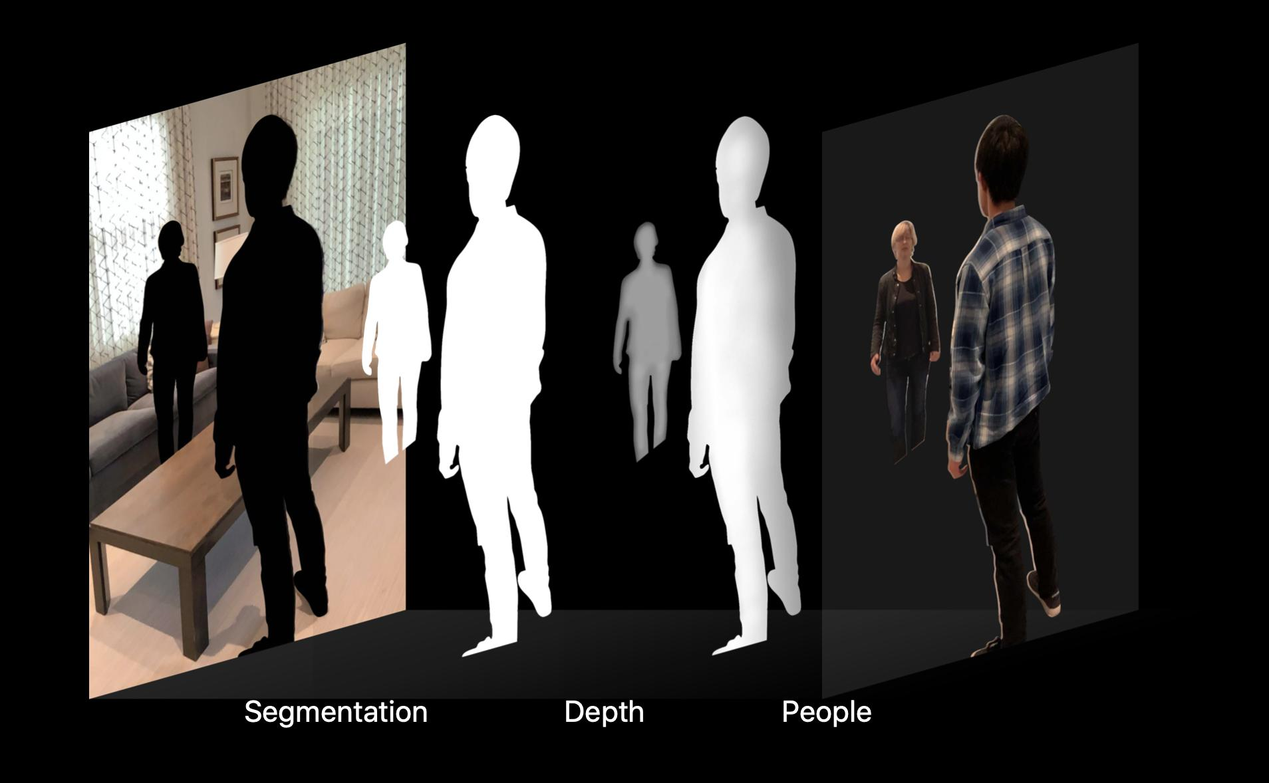

Slide 6
People Occlusion
Segmentation and depth buffer
Only from camera image using machine learning
60fps, reduced resolution for Machine Learning algorithm
Use Matting to get back the missing details with help of segmentation buffer
Composition

Slide 7
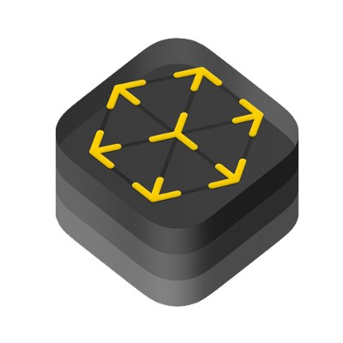

RealityKit
ARView, recommended for new apps
Deep renderer integration, transparent objects, better performance
Built-in support for people occlusion
ARWorldTrackingConfiguration

Slide 8

SceneKit
Added support to ARSCNView
Just enable frame semantics
Does composition as a post-process
May not work well with transparency

Slide 9

Metal
Custom composition
Integrate into your own renderer
ARMatteGenerator gives texture to perform custom operations on

Slide 10
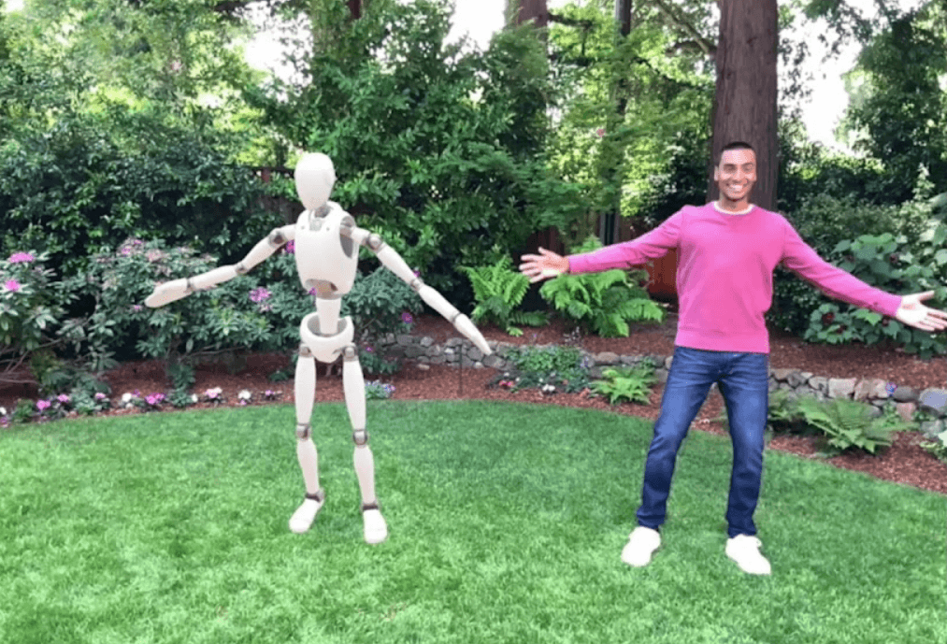

Slide 11
Body tracking
Track movement of people in real-time
Integrated with ARKit 3 and RealityKit
Powered by Machine Learning

Slide 12
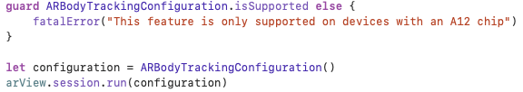
RealityKit
Access tracked person via AnchorEntity
Automatically gathers motion transforms
ARBodyTrackingConfiguration

Slide 13

RealityKit
ARSessionDelegate
BodyTrackedEntity
Represents a Person
Contains skeleton and position
Updated every frame
Applies the skeleton to a .usdz model

Slide 14
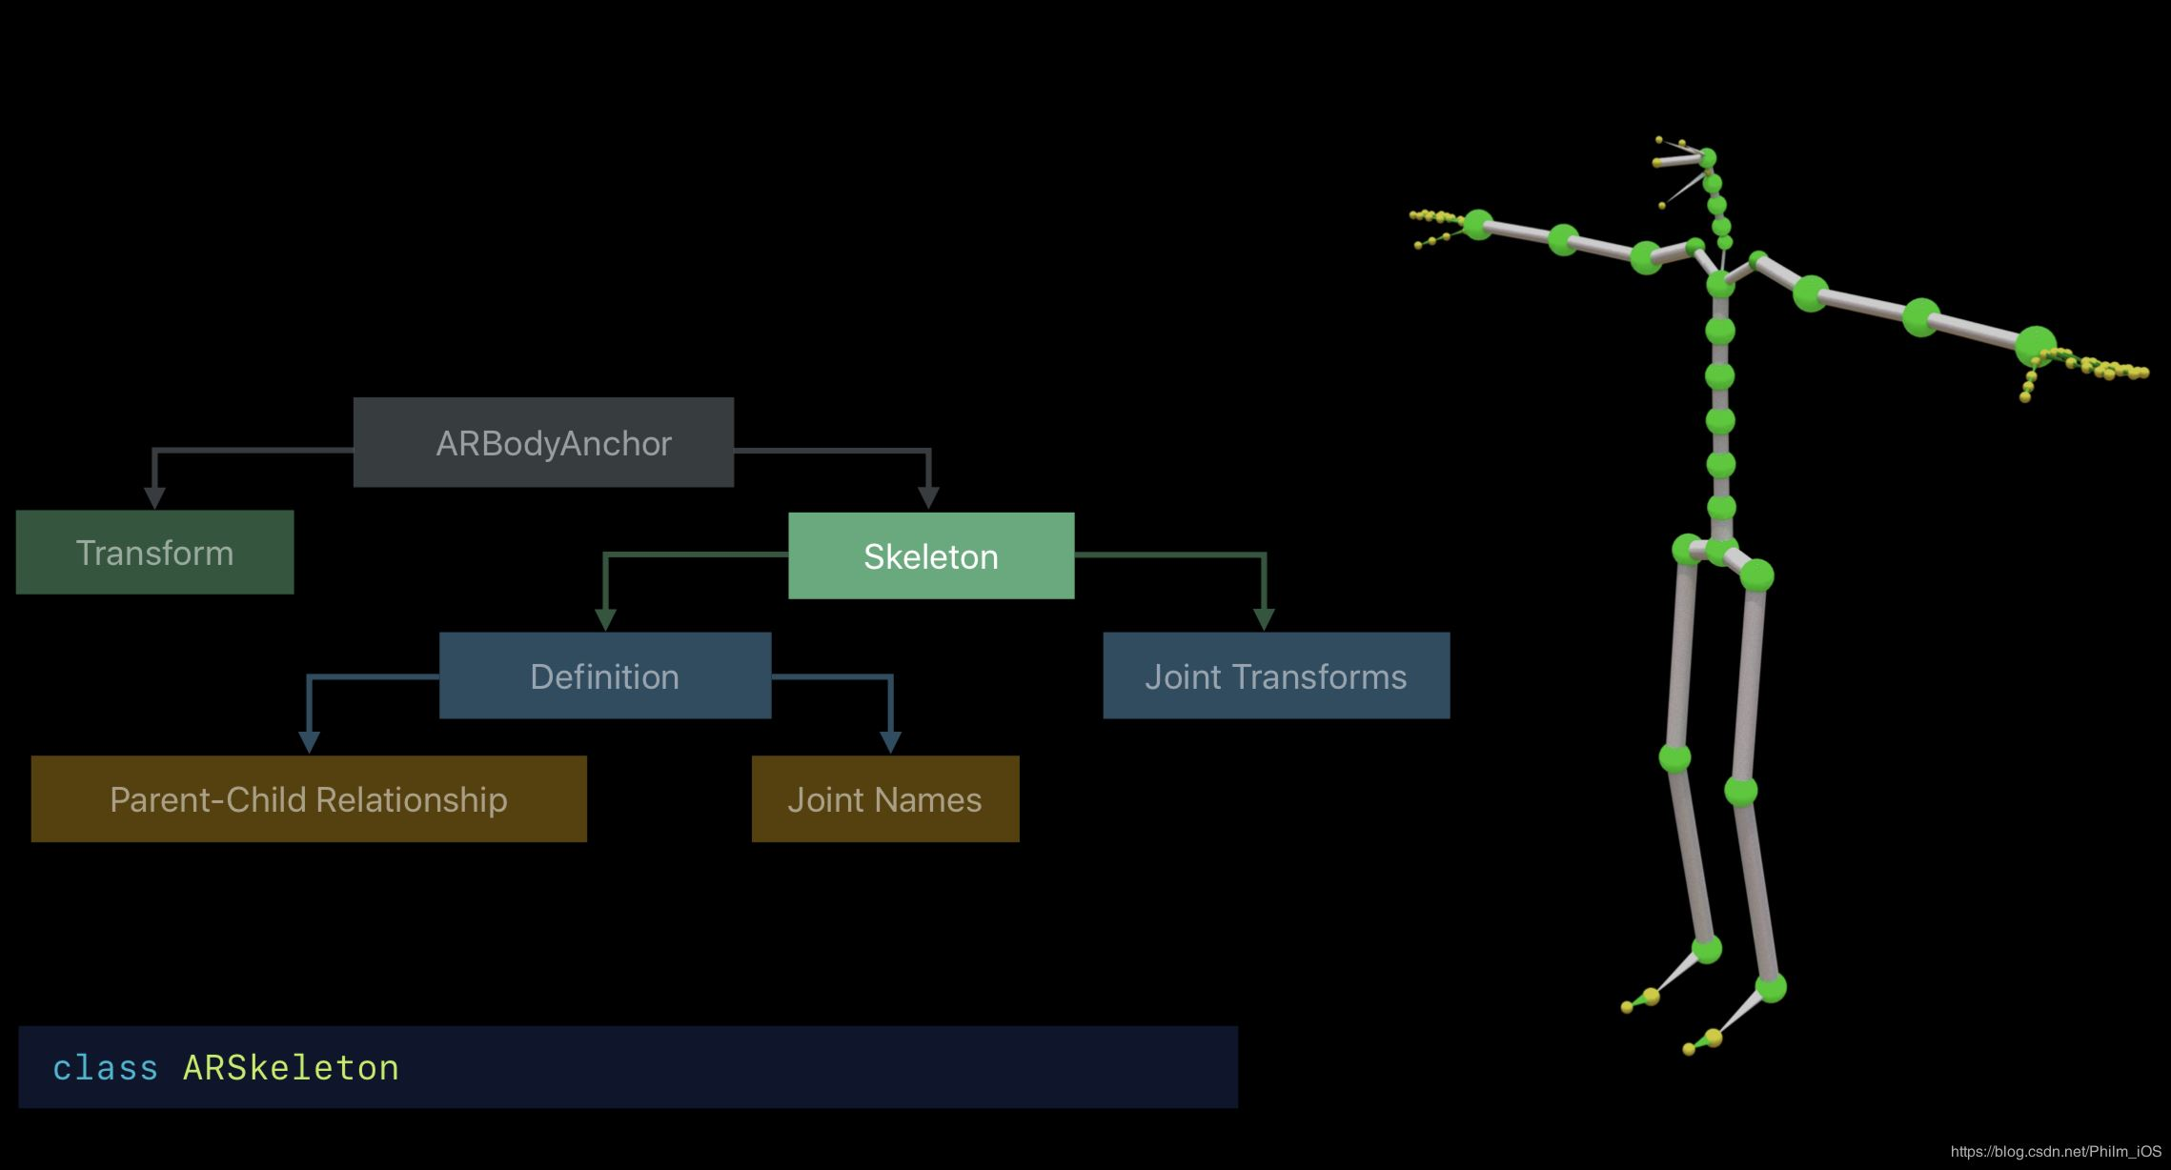
ARBodyAnchor

Slide 15
Extracting Data from 2D skeleton
Access to 2D skeleton through ARBody2D object
Similar structure to
Normalized image coordinates
For image analysis

Slide 16
ARWorldMap
Map of sparse 3D landmarks
List of named ARAnchors
Possible to save and reload ARSession when App gets killed and restarted
Multiplayer opportunities
Compare world maps of two users and merge on same landmarks
Shared AR Experience starts after seeing same area (from similar angle)
See other users ARAnchors
ARParticipantAnchor (position of other user)

Slide 17
More Code Explanation…

Slide 18
Demo

